Slide 1


Introduction to Time Series Analysis
Fondren Library
Digital Scholarship Services

Slide 2
WHAT ARE TIME SERIES?
Simply, data that are collected in a certain order
Evenly or unevenly spaced
Any number of variables

Slide 3
WHAT’S SO SPECIAL ABOUT TIME?
Many statistical models depend upon data points being independent
Linear Regression
Logistic Regression
Many more!
With time series, this basic assumption underlying the entire model can be wrong!
Disastrous results

Slide 4
WHY IS THIS IMPORTANT?
Time series are extremely useful for forecasting
Weather
Stocks (although this is very hard!)
Sports predictions
Election predictions
Well suited to a wide class of problems

Slide 5
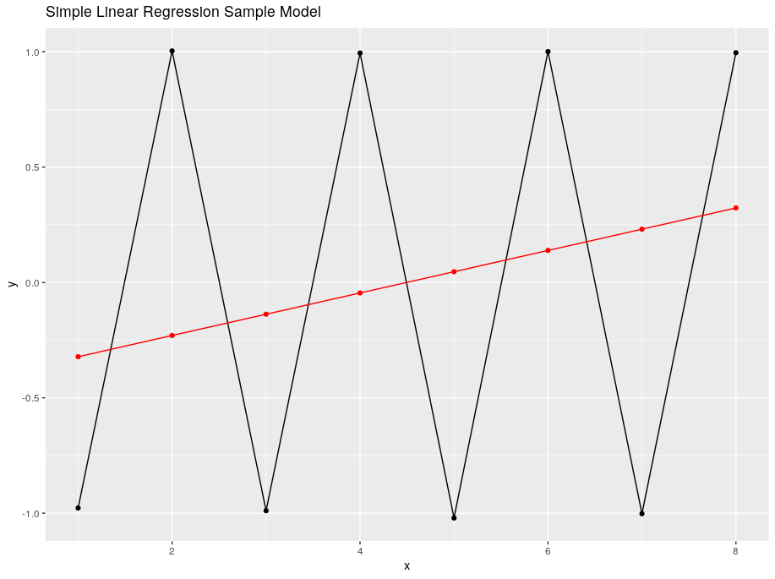
ONE QUICK EXAMPLE
Simple Linear Regression vs. a Time Series Model (ARIMA)

Slide 6
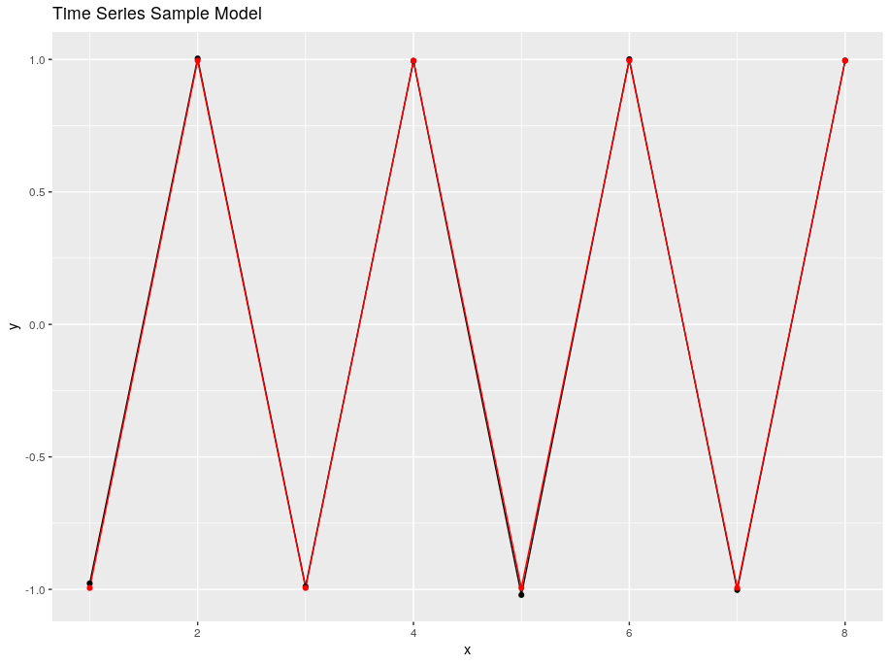
ONE QUICK EXAMPLE
Simple Linear Regression vs. a Time Series Model (ARIMA)

Slide 7
TRENDS AND SEASONALITY
How to filter out the noise and model what really matters

Slide 8
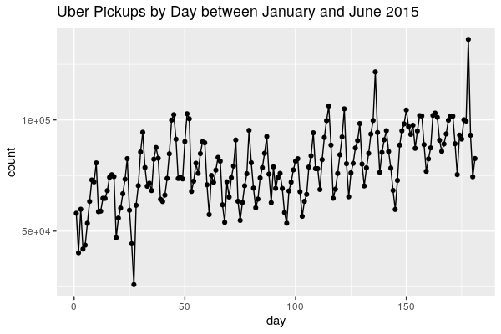
A SAMPLE TIME SERIES

Slide 9
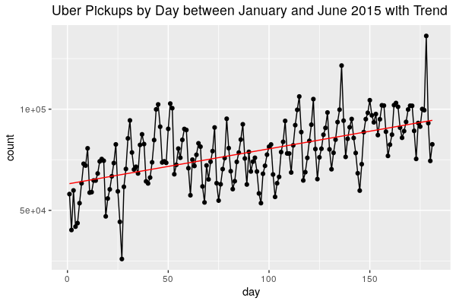
TRENDS

Slide 10
PERIODIC COMPONENTS
Cycles that repeat
Commonly by month, day of week, day of year, etc.
Also called seasonality

Slide 11
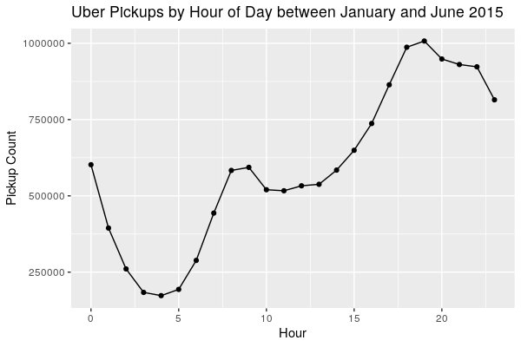
BY HOUR OF DAY

Slide 12
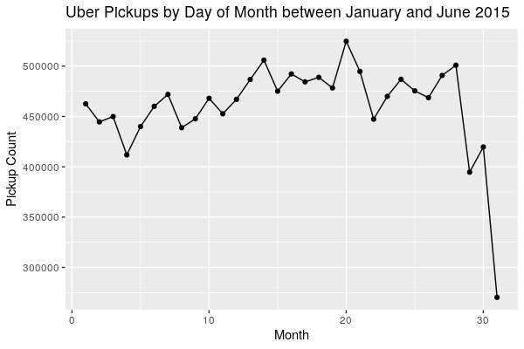
BY DAY OF MONTH

Slide 13
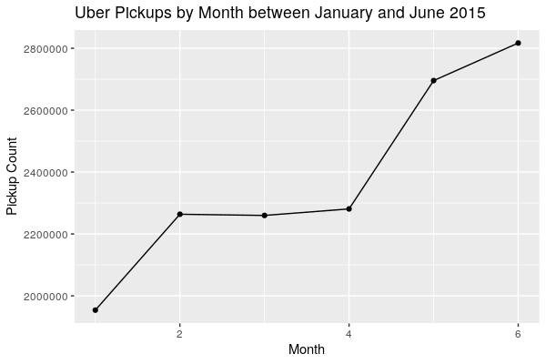
BY MONTH

Slide 14
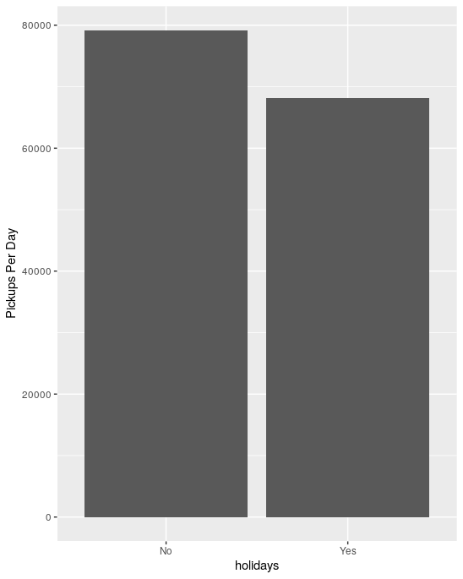
HOLIDAYS

Slide 15
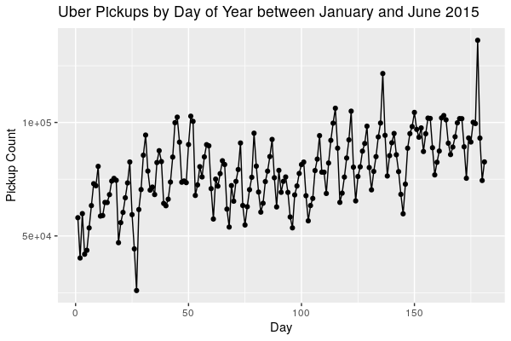
LOOKING BACK AT IT

Slide 16
WHITE NOISE
Not very easy to quantify, but the assumption is that there is some randomness we haven’t accounted for
The statistician’s approach: assume this randomness behaves nicely so we can build some great models!

Slide 17
HOW TO MAKE YOUR DATA STATIONARY
Make your data appetizing for modeling

Slide 18
WHAT IS STATIONARY DATA?
Intuitively, it doesn’t matter where you are in the series
If it’s Monday or Friday, you can model it the same way
Once we have our data stationary (or at least close), we can build amazing models!
Can’t have a trend
If we do, we need to know when we are
Should minimize interaction between data points

Slide 19
DETRENDING
Subtracting our estimate of the data looking at trend only
But where do we get the trend from?
We have to estimate it ourselves!
What kind of trend is it? Trends don’t have to be linear!
Something else that could go wrong…
Can we do better?

Slide 20
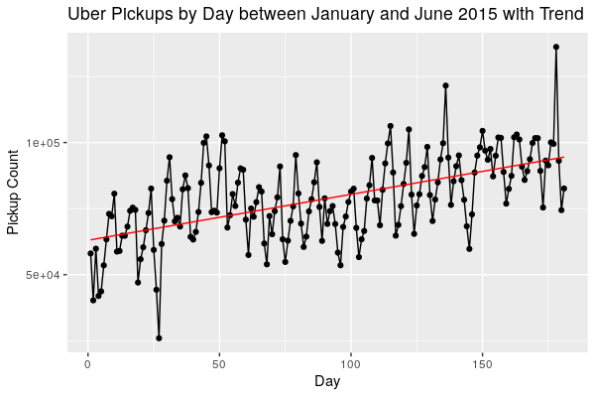
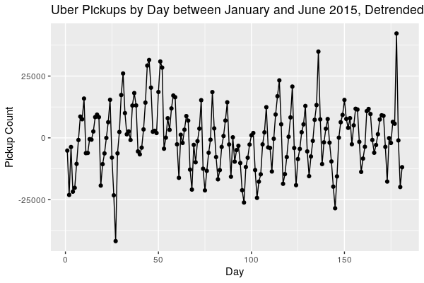
DETRENDING EXAMPLE
Subtracting our estimate of the data looking at trend only

Slide 21
DIFFERENCING
Subtracting values separated by some constant value
Say we have a list of 1, 7, 10, 13, and 2
First order difference: 7-1, 10-7, 13-10, 2-13
Third order difference: 13-1, 2-7
Losing data at the start!
If there’s a linear trend, first order differencing will get rid of it!
You can do higher orders for quadratic trends, etc.
Also used for removing some cyclic effects
Weekly cycle? Difference by 7!
Can do many of these at once

Slide 22
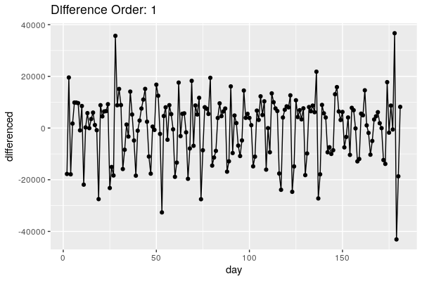
DIFFERENCING EXAMPLE: 1st ORDER

Slide 23
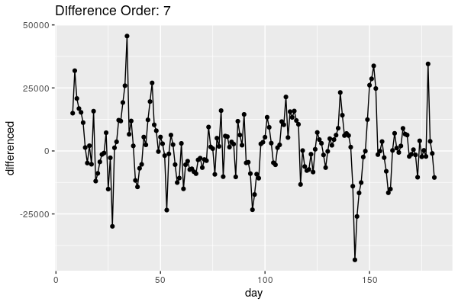
DIFFERENCING EXAMPLE: 7th ORDER

Slide 24
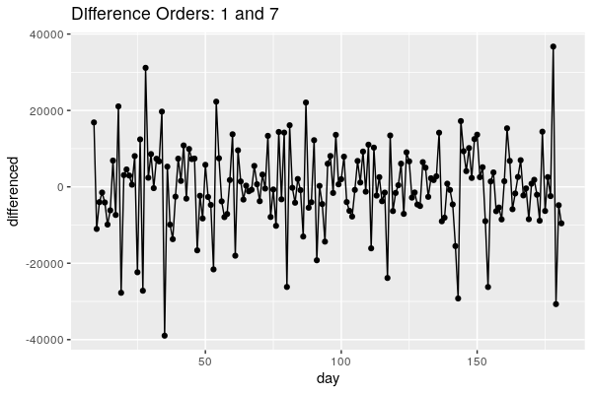
DIFFERENCING EXAMPLE: BOTH!

Slide 25
LAGGED SCATTERPLOTS
How do you know what orders are likely to help?
Lagged scatterplots!
Essentially, plotting one point versus a previous point
If there’s an obvious trend (either positive or negative) it’s probably a good idea to try differencing!

Slide 26
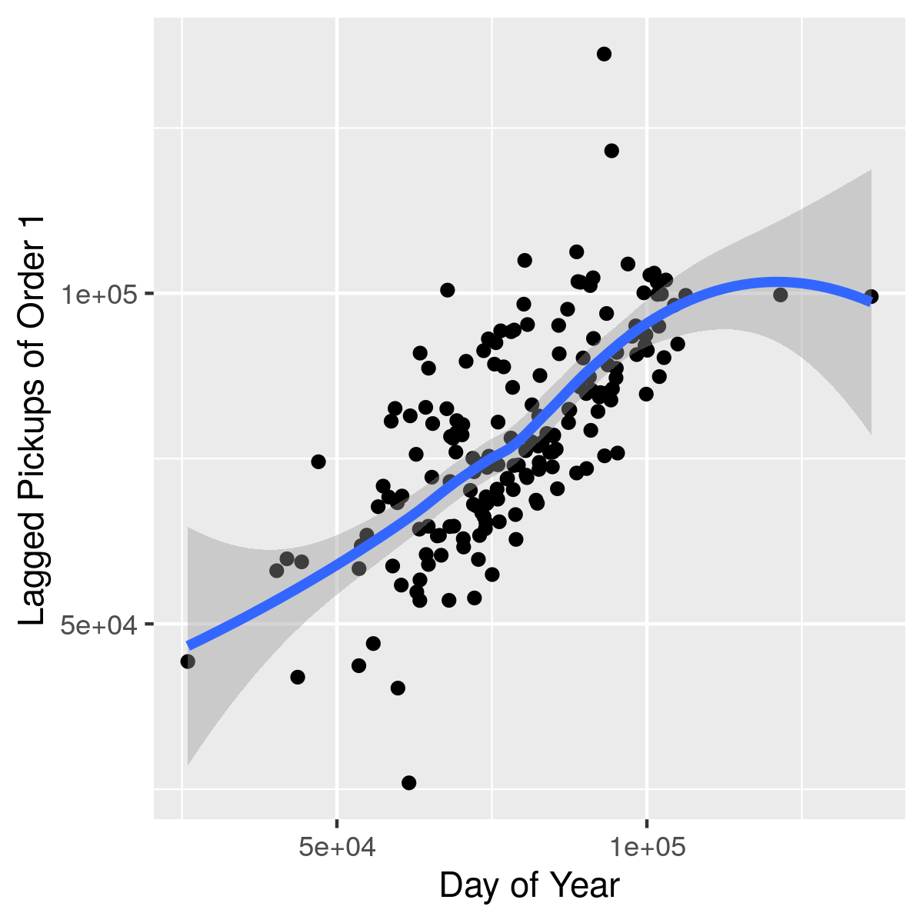
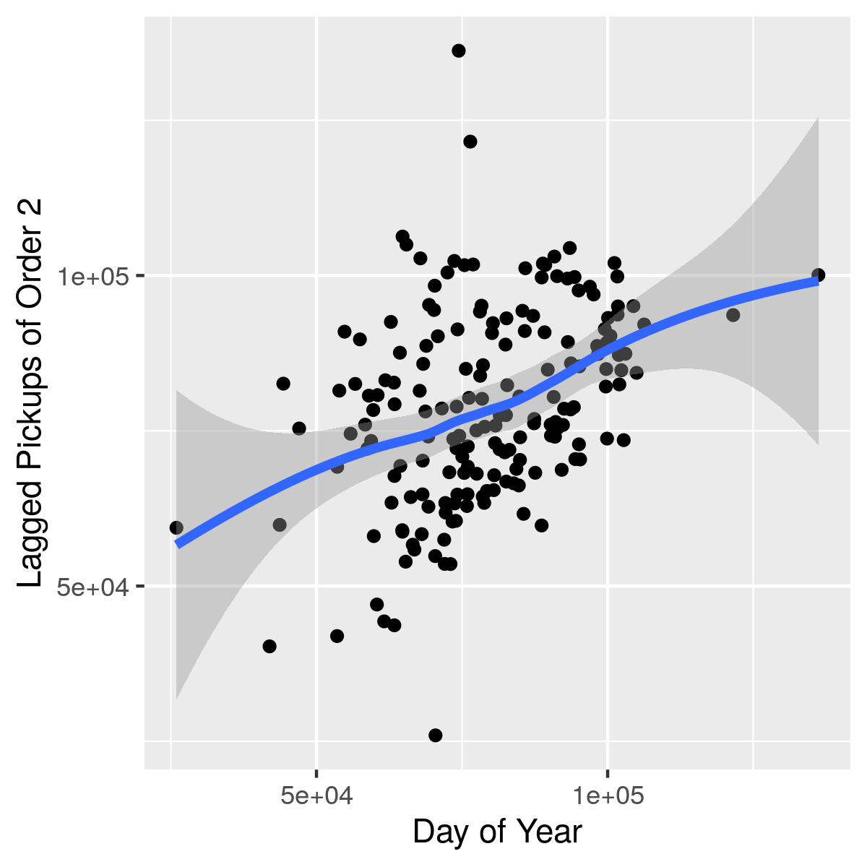
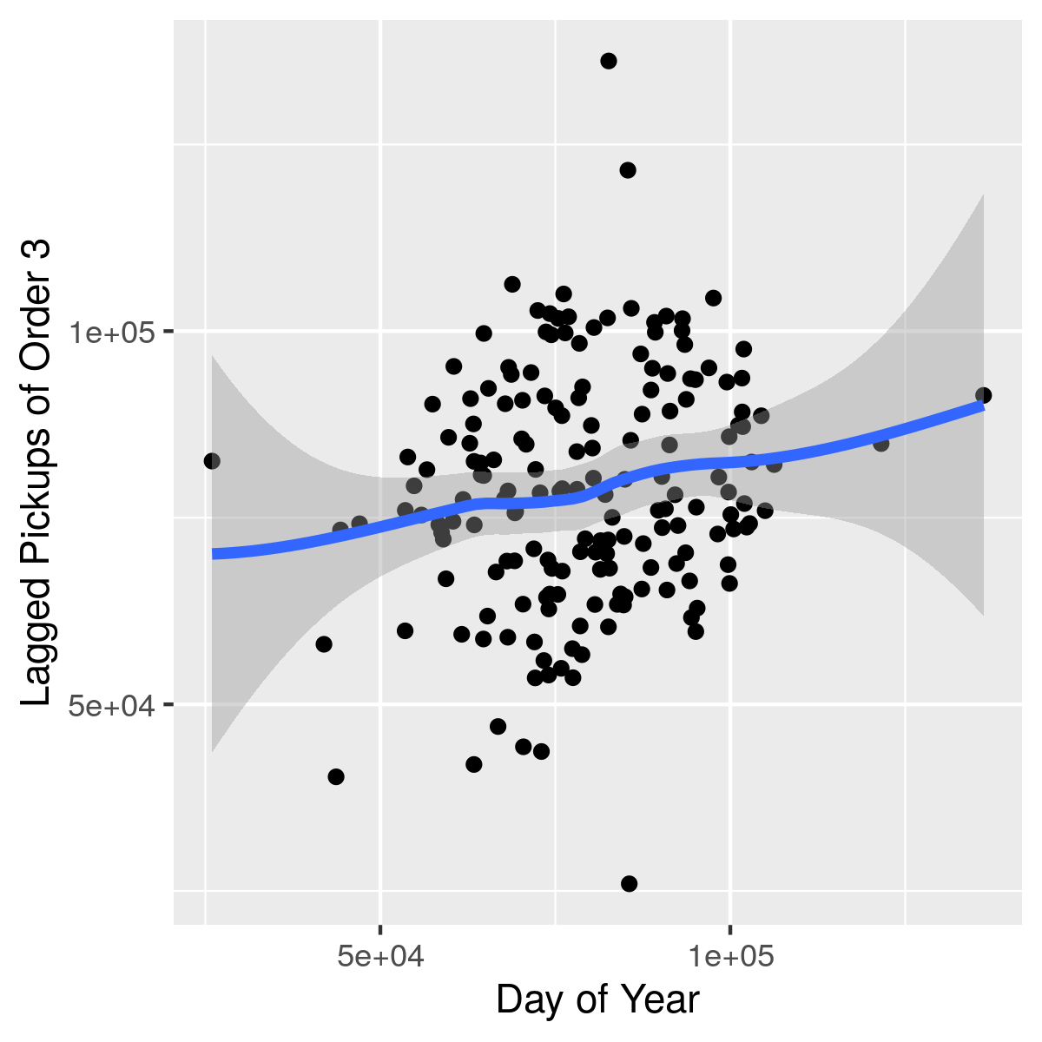
LAGGED SCATTERPLOTS EXAMPLE

Slide 27
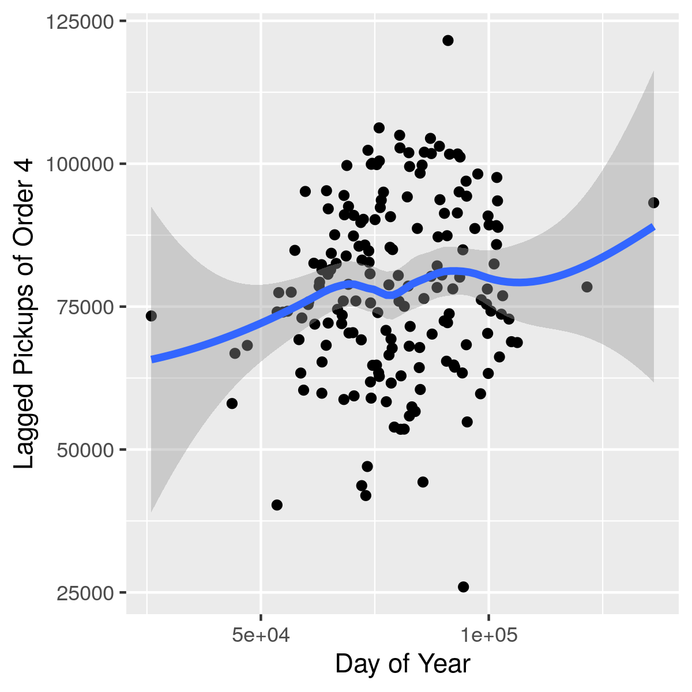
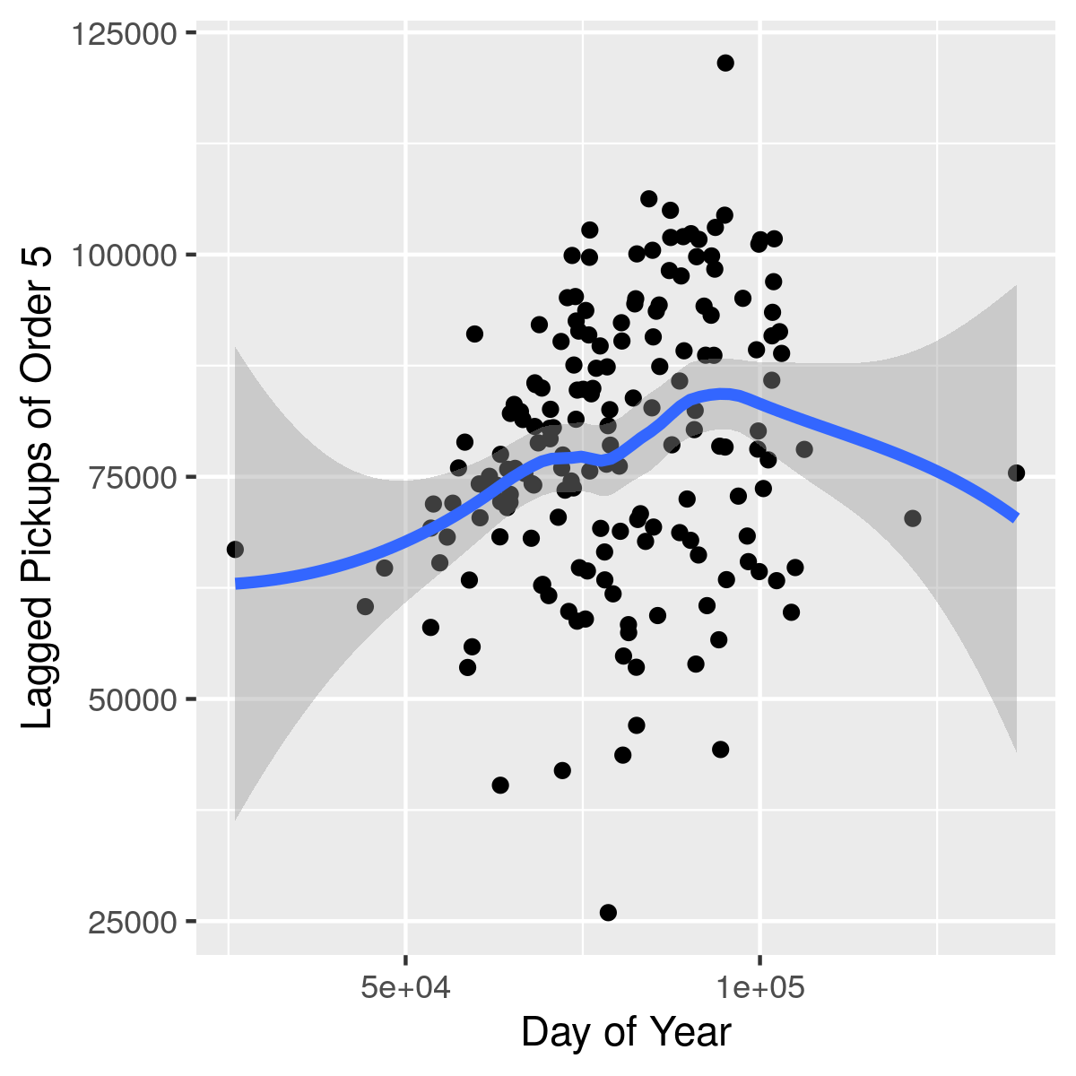
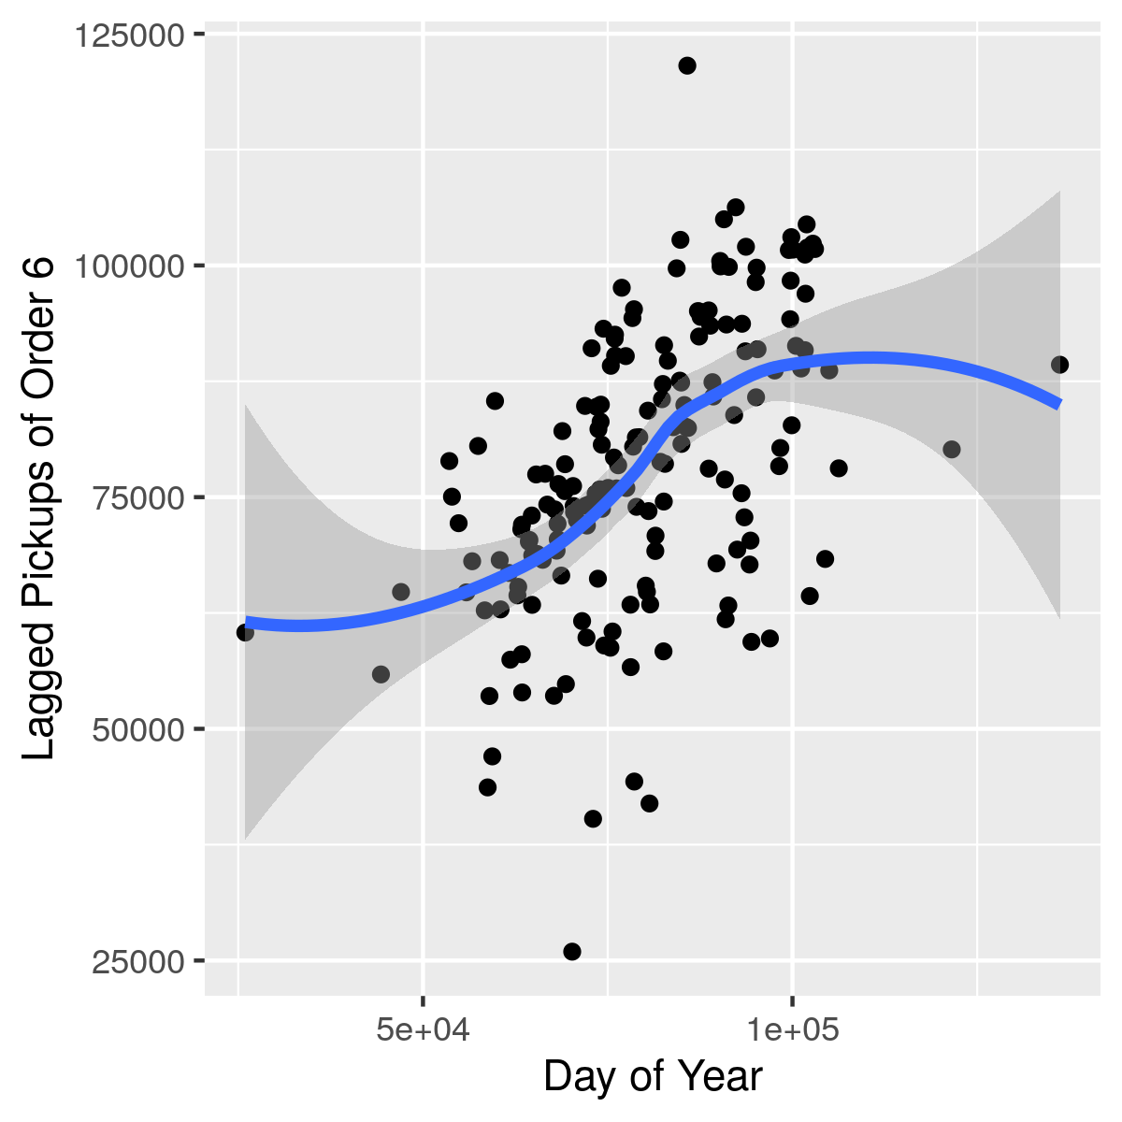
LAGGED SCATTERPLOTS EXAMPLE

Slide 28
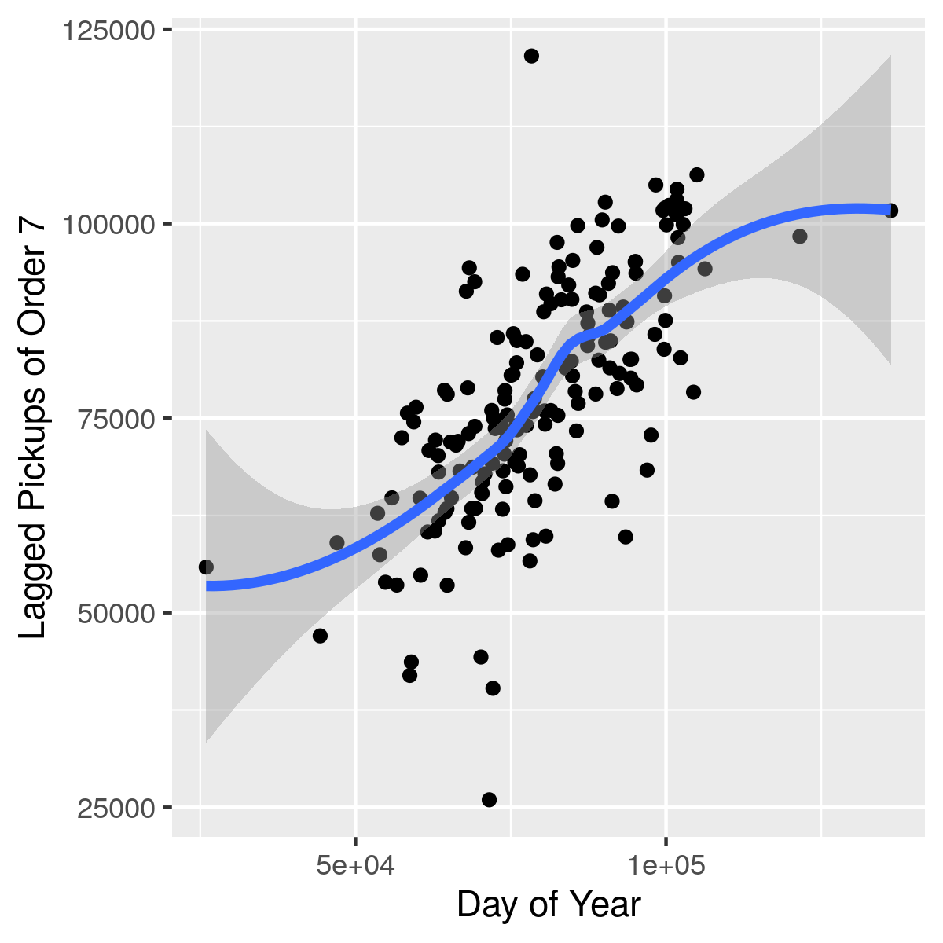
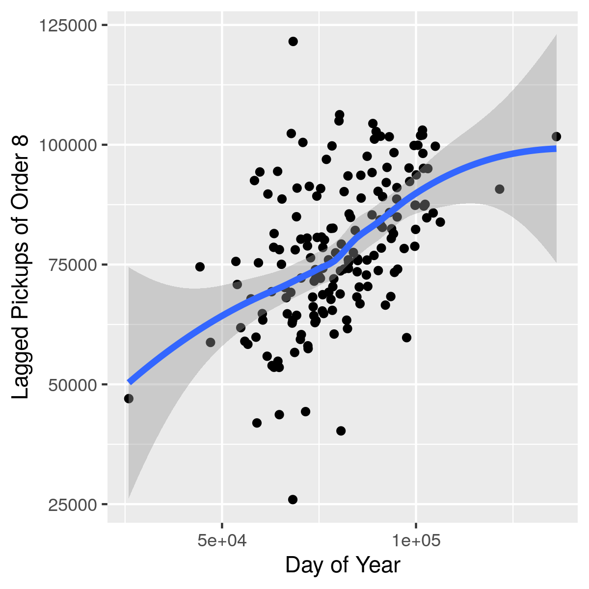
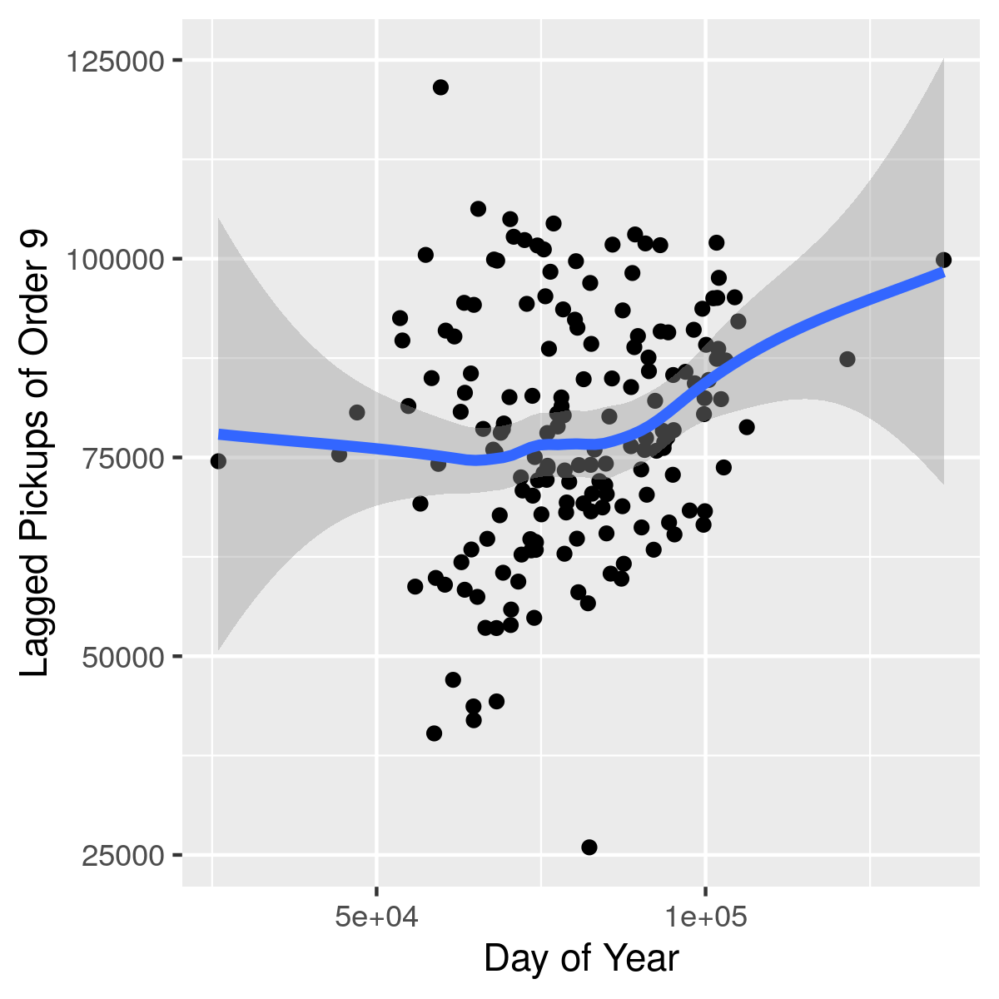
LAGGED SCATTERPLOTS EXAMPLE

Slide 29
HOW DO I KNOW I’M STATIONARY?
The Augmented Dickey-Fuller test to the rescue!
The p-value in the output is a measure of how stationary the series is
If you have less than ~0.05, you’re all set to model!
Python
from statsmodels.tsa.stattools import adfuller
adfuller(Your Time Series)
R
library(tseries)
adf.test(Your Time Series)

Slide 30
A FEW NOTES
On modeling, forecasting, evaluating, plus explaining what these plots mean

Slide 31
MY MODELING PHILOSOPHY
“All models are wrong, but some are useful” – George Box
You’ll never get everything right
Try a bunch of things and see what works!
Interpretability matters
If we can predict well but we have absolutely no idea why, is the model really what we want?

Slide 32
MODELING FOR FORECASTING
If we use all our data to model, and then “forecast” based on that, we’re cheating!
A model could just memorize what we put in and get a perfect score
The real test of a model is its ability to forecast on unknown data
Solution: choose a point (usually ~70% of the way through the data set) and split the data into two chunks: before and after
Model with the first chunk, and check forecasting ability on the second chunk

Slide 33
EVALUATING MODELS
Common statistical measures don’t apply well to time series
I’m going to be using mean relative error, which measures how close our predictions are on average to the true value
Another common metric: Mean Root Squared Error

Slide 34
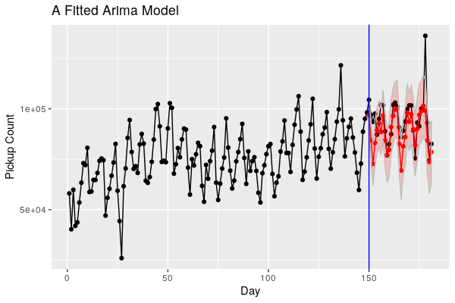
A SAMPLE FORECAST GRAPH
Vertical blue line: switch from train to test
Red: predictions
Faint red ribbon: a prediction interval, if applicable
Basically, “I think it’s probably in here somewhere”

Slide 35
ARIMA MODELS
Interpretable, simple and speedy time series modeling

Slide 36
ARIMA MODELS
Auto-Regressive Integrated Moving Average models
Pros:
Great at producing flexible models, solid support of periodic behavior and trending
Parameters are fairly easy to interpret
Widely used and mathematically well-understood
Cons:
Bit of a pain to figure out the right parameters
Not great at dealing with holidays, etc

Slide 37
WHAT IS AUTOCORRELATION?
A measure of how much values depend on previous values
The “autoregressive” part of ARIMA
So we’re modeling based on the assumption that these relationships matter and aren’t just random noise

Slide 38
WHAT’S A MOVING AVERAGE?
Essentially, a sliding window of interest upon which we take an average
Say we have a list of 1, 7, 10, 13, and 2
A moving average of order 3 would take all triples of components and average them
(1 + 7 + 10)/3, (7 + 10 + 13)/3, (10 + 13 + 2)/3
Notice we’re losing data points!
A kind of smoothing to reduce the effect of massive spikes

Slide 39
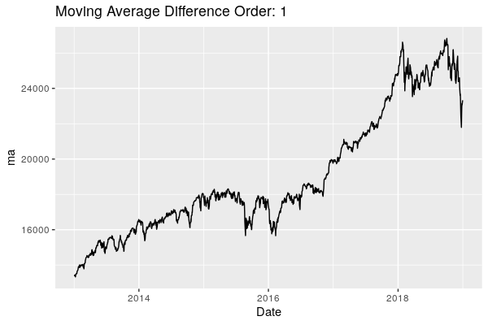
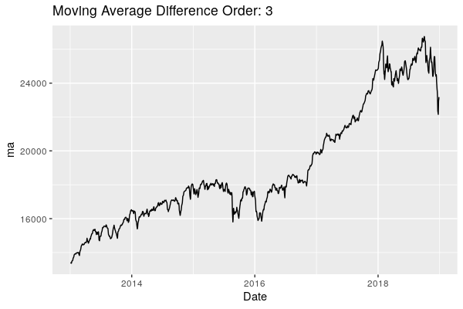
MOVING AVERAGES IN ACTION: 1 & 3

Slide 40
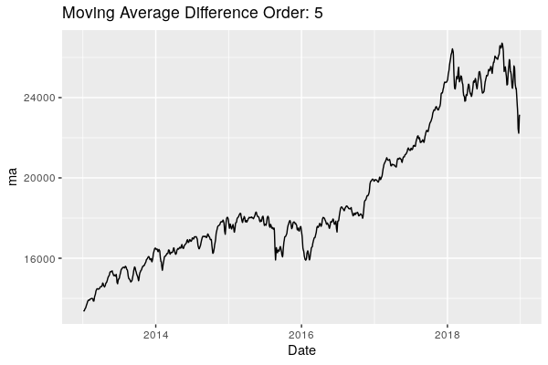
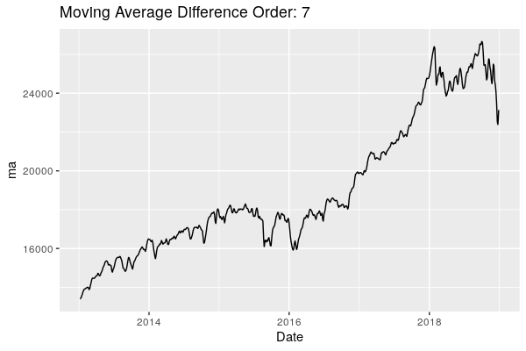
MOVING AVERAGES IN ACTION: 5 & 7

Slide 41
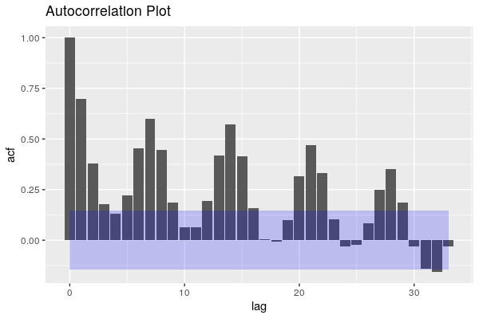
AUTOCORRELATION PLOTS
A plot of a range of autocorrelations for different orders
How far back do we look?
Find the lag to the right of which the columns are (mostly) within the blue region

Slide 42
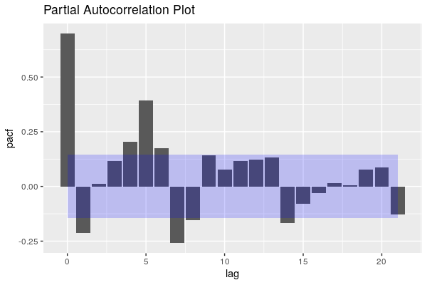
PARTIAL AUTOCORRELATION PLOTS
A plot of a range of partial autocorrelations for different orders
How much smoothing do we apply?
Estimates the moving average component
Find the lag to the right of which the columns are (mostly) within the blue region

Slide 43
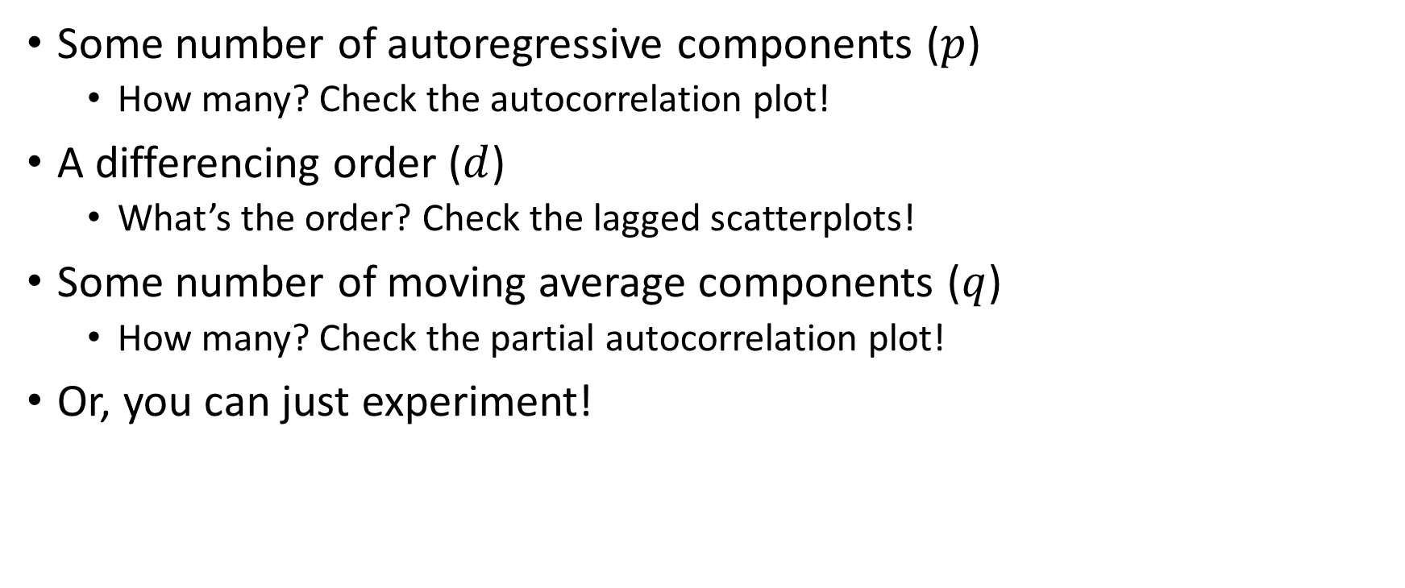
ARIMA COMPONENTS
Some number of autoregressive components ($p$)
How many? Check the autocorrelation plot!
A differencing order ($d$)
What’s the order? Check the lagged scatterplots!
Some number of moving average components ($q$)
How many? Check the partial autocorrelation plot!
Or, you can just experiment!

Slide 44
BUILDING THE MODEL
R
arima(Your Time Series, order=c(p, d, q))
Python
from statsmodels.tsa.statespace import sarimax
sarimax.SARIMAX(Your Time Series, order=(p, d, q))

Slide 45
A FEW THINGS ABOUT ARIMA
Modeling is slow, especially when compared to our next class of models
Figuring out what values to use for the orders is not an exact science
Our plots give us a good idea, but it’s a good idea to try a few more in the general area
Can do a grid search, for example
Automatically try a bunch of models and see what works

Slide 46
AN ARIMA MODEL
Mean Relative Error: 5.6%
Follows peaks nicely!
Only major miss is the huge spike

Slide 47
ARIMA IN SUMMARY
Explore your data with plots
Plot by day, day of week, day of month, month, hour, minute, etc.
This will help you get a feel for the data
Try out some lags, moving averages, and detrending
If you can get a stationary data series, remember what you did to get there!
Estimate parameters
Use (partial)autocorrelation function to figure out the order of moving average and autoregressive components
Use lagged scatterplots to deal with
Model, forecast, and repeat!

Slide 48
ARIMA EXTENSIONS
Won’t explore these here
Seasonal ARIMA: better support for seasonal cycles (longer range)
Even more parameters to figure out
ARIMAX: use external variables to help prediction
Maybe if we knew the unemployment rate, that would help us predict inflation
Usually pretty simple
SARIMAX: both!

Slide 49
PROPHET MODELS
Facebook’s in-house forecasting tool

Slide 50
PROPHET MODELS
Cutting up a forecast
Pros:
Fast and scalable
Parameters are very easy to understand
Deals with holidays very elegantly
Splitting models up allows even more flexibility
Performs quite well! Results often better than ARIMA
Cons:
Not as widely used (released in Sept. 2017)!
The jury’s still out on this one

Slide 51
CHANGEPOINTS
Segment data into various sections and model them differently
Why? Maybe things actually have changed
In business, there can be some major shakeups
It doesn’t always make sense to predict based on what happened twenty years ago. Is that data even still applicable?
Automatically detected by prophet

Slide 52
HOLIDAYS
Large list of holidays
Maybe things do change on a New Year’s Day
People are going to want to be picked up after partying, but are drivers going to be working?

Slide 53
SEASONALITY
The cyclic components we noted earlier
Do things repeat every day? week? hour?
Extremely easy to deal with in prophet
Just enable the seasonalities in the modeling call

Slide 54
SOME ANNOYING CONVENTIONS
Prophet requires that your data be arranged in a very specific way
ARIMA doesn’t
Rename your date column to ‘ds’ and convert it to a datetime format
Rename the variable you want to model to ‘y’

Slide 55
BUILDING THE MODEL
R
library(prophet)
prophet(dataframe, yearly.seasonality=TRUE, …)
Python
import fbprophet
fbprophet.Prophet(dataframe,
yearly_seasonality=TRUE, …)

Slide 56

A PROPHET MODEL
Mean Relative Error: 7.4%
Very interested in cycles
Not bad, but slightly worse than ARIMA
Much faster, though

Slide 57
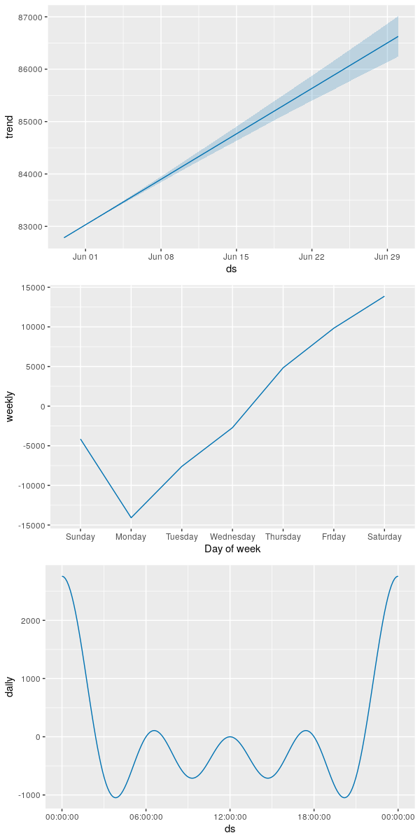
DECOMPOSING
Look at individual components of the model
trend, weekly and daily seasonality
R
prophet_plot_components
Python
model.plot_components

Slide 58
NEURAL NETWORK APPROACHES
Breaking out the big guns

Slide 59
NEURAL NETWORK MODELS
Incomprehensible but extremely powerful
Pros:
Often extremely accurate
Cons:
More or less impossible to understand what any of the parameters mean
Can take a very long time to train the model (can be days)
Lots of moving parts and things that can go wrong
But depending on the problem, that one pro may outweigh all the cons

Slide 60
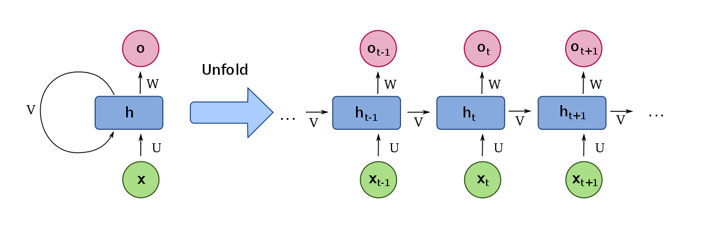
RECURRENT NEURAL NETWORKS
Simplest time series applicable neural network model
Neural net that feeds back into itself

Slide 61
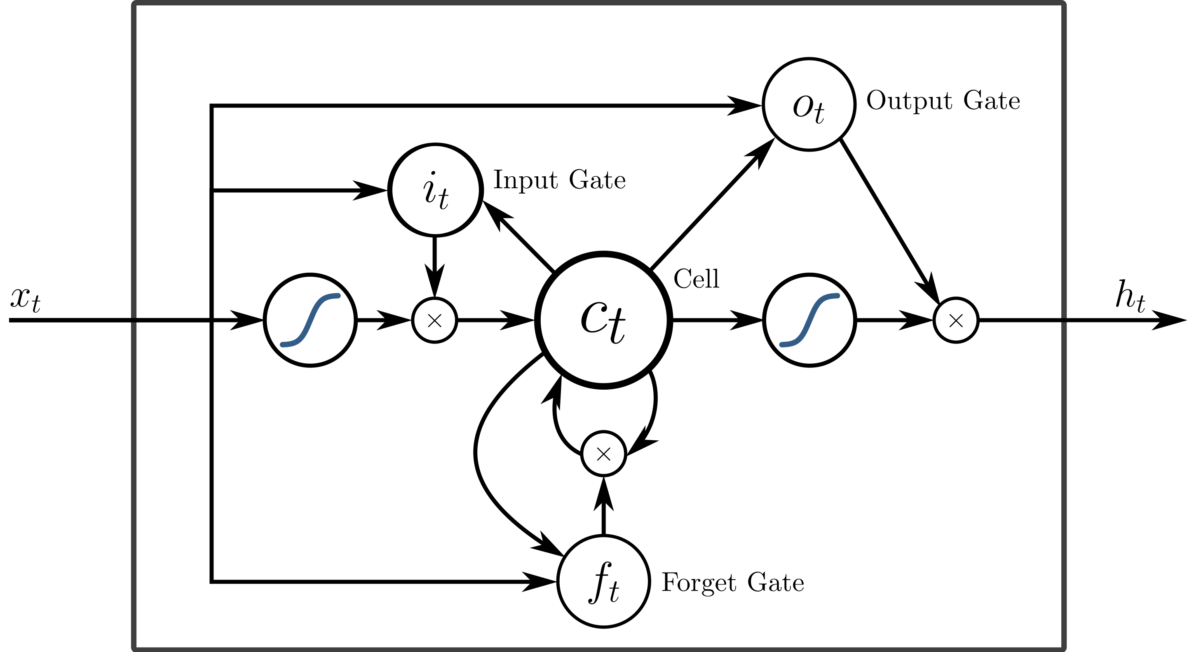
LONG SHORT-TERM MEMORY
Cells and gates
Forget gate
Input gate
Output gate
Basically, LSTM models ‘learn’ how long they need to pay attention
Don’t worry about the details!

Slide 62
BUILDING AN RNN MODEL
R
library(keras)
keras_model_sequential() %>%
layer_simple_rnn(units) …
Python
import keras.models
model = models.Sequential([
SimpleRNN(units) …
])

Slide 63
BUILDING AN LSTM MODEL
R
library(keras)
keras_model_sequential() %>%
layer_lstm(units) …
Python
import keras.models
model = models.Sequential([
LSTM(units) …
])

Slide 64
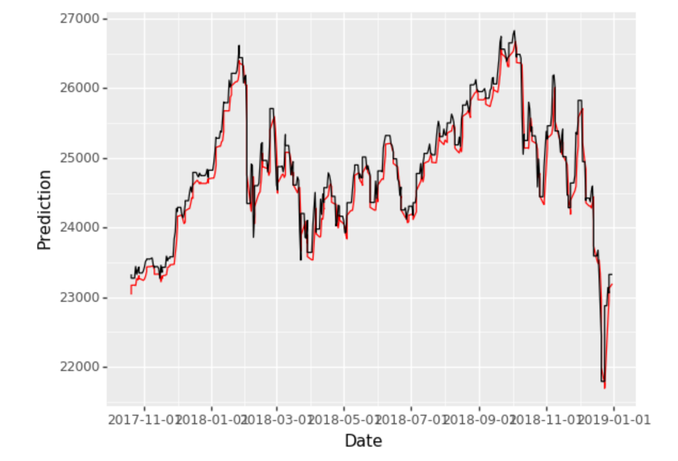
LSTM HIGHLIGHT
If given enough data, an LSTM can produce ridiculously good results.
Here’s the best model I made on the Dow Jones data:

Slide 65
COMPARISON AND SUMMARY
A look back at our models

Slide 66
MODEL COMPARISON: ARIMA
Mean Relative Error: 5.6%
Follows peaks nicely!
Only major miss is the huge spike

Slide 67
MODEL COMPARISON: PROPHET
Mean Relative Error: 7.4%
Very interested in cycles
Not bad, but slightly worse than ARIMA
Much faster, though

Slide 68
MODEL STRENGTHS
ARIMA
Flexible, interpretable, not too complicated to estimate parameters, easy to tweak
Prophet
Great for business-style forecasting (Facebook’s interest), fast, interpretable, holidays, longer seasonality
Simple RNN
Somewhat less complicated than LSTM
LSTM
Highest ceiling, extreme flexibility

Slide 69
MODEL WEAKNESSES
ARIMA
Bad at longer seasonal trends, never forgets
Prophet
Annoying interface, not a mature package
Simple RNN
All the drawbacks of LSTM, but also less flexibility
LSTM
Can be very finicky to train, uninterpretable, extremely slow and resource-intensive, requires tons of data

Slide 70
MY PERSONAL ADVICE
Visualize your data extensively
Lots of great insights can be found
Lagged scatterplots, plots by day/week/hour of day, (partial)-autocorrelation plots
Make it stationary
This will help you understand the data more
Start with a Prophet model
Quick and fast
Try out a few ARIMA models
Tweak the parameters a little bit
If, and only if, these models don’t meet your needs, build and tune an LSTM

Slide 71
ACKNOWLEDGMENTS
Plots were created using the ggplot2 package in R
Shumway and Stoffer’s Time Series Analysis and Its Applications With R Examples, Fourth Edition published by Springer was used as the main reference for the ARIMA section
Forecasting at Scale by Sean J. Taylor and Benjamin Letham was used as the main reference for the Prophet section
The pictures under Neural Networks are licensed for free use under Wikimedia Commons
Uber data provided by a Rice faculty member, not made public here
Dow Jones data (used in the exercises) downloaded from Yahoo! Finance

